Slide 1
Air Traffic Landing Analytics & Anomaly Detection System
Rakshith Narayanaswamy
Ziming Liang
Notes:
Add names

Slide 2
Project Idea
Idea
Analyzes historical air traffic landing data
Detects abnormal flight behavior
Forecasts future landing volume and weight
Objectives
Perform batch-level historical trend modeling
Support reactive anomaly detection
Generate interpretable forecasts for future months

Slide 3
Data Source
Dataset
Source: San Francisco International Airport (SFO)
File: Air_Traffic_Landings_Statistics_20251118.csv
Data Magnitude
Over 44,000+ landing records
Time Span: Multi-year monthly history
Each row includes:
Time period, Airline, Aircraft type, Landing count, Landed weight

Slide 4
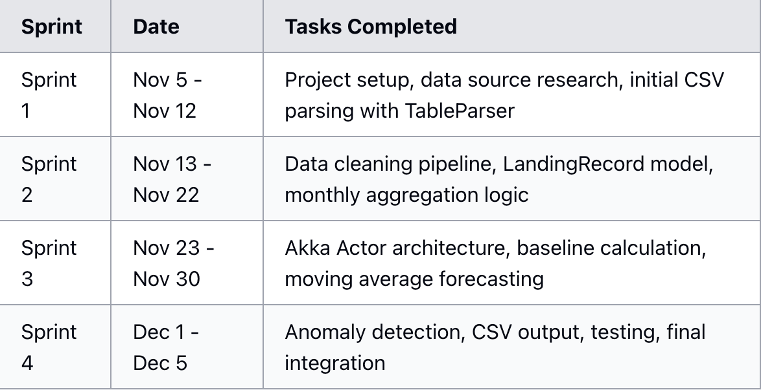
MILESTONES
Notes:
Usage: Scala, with its functional programming capabilities, is used for application development. Spark, built on Scala, excels in processing large datasets in real-time.
Usage: MLlib is used to develop machine learning models that form the backbone of the recommendation engine.

Slide 5
What We Programmed in Scala
Implemented in Scala
Typed CSV Parsing (TableParser)
Data Cleaning & Transformation (Formats.scala, LandingReader)
Domain Model (LandingRecord)
Aggregation Logic (monthly grouping & baseline computation)
ForecastService (MA-6 model & trend-based forecasting)
Akka Typed Actors
Output Writers (forecasts.csv, anomalies.csv)
LandingRecommender — anomaly detection
RecordKeeper — anomaly storage + CSV writing
Guardian — system supervision
Notes:
Usage: Scala, with its functional programming capabilities, is used for application development. Spark, built on Scala, excels in processing large datasets in real-time.
Usage: MLlib is used to develop machine learning models that form the backbone of the recommendation engine.

Slide 6
Tech stack
Scala 2.13 + Akka Toolkit
Akka Actors - Concurrent message-driven architecture
Akka Streams - Reactive data processing
Apache Spark - Batch analytics
TableParser
ScalaTest + Akka TestKit - Testing framework
Notes:
Usage: Scala, with its functional programming capabilities, is used for application development. Spark, built on Scala, excels in processing large datasets in real-time.
Usage: MLlib is used to develop machine learning models that form the backbone of the recommendation engine.

Slide 7
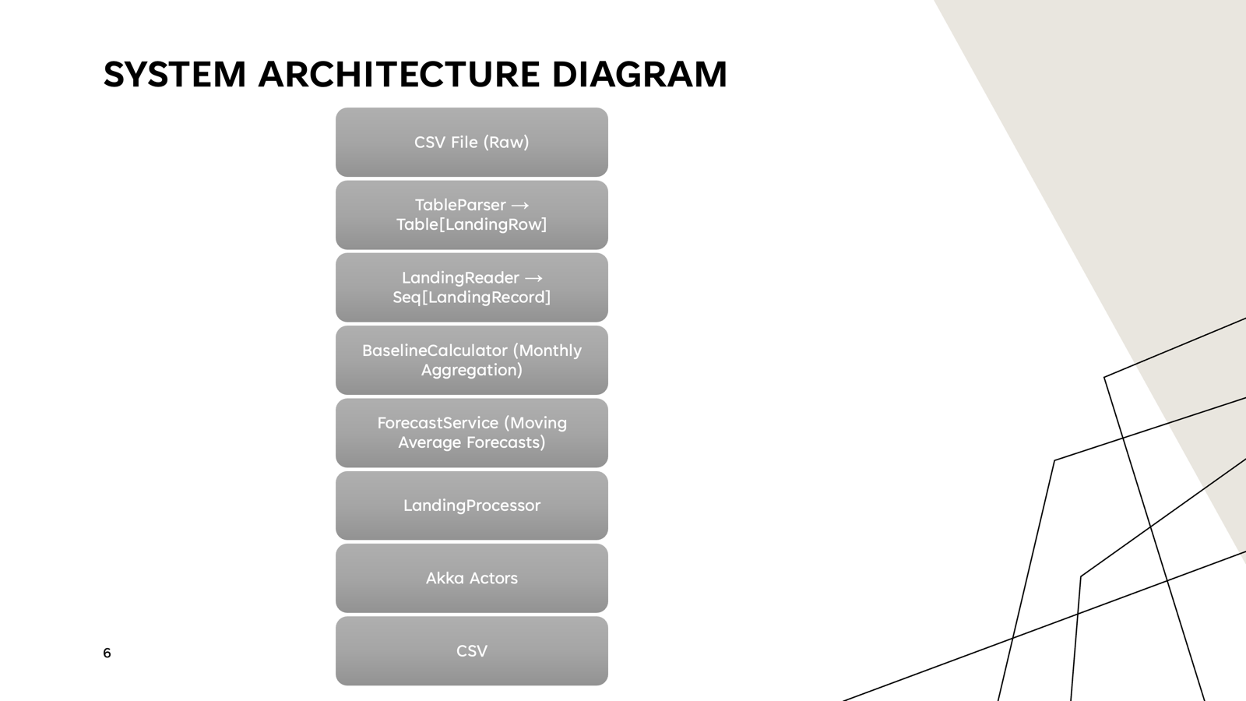
Notes:
Usage: Scala, with its functional programming capabilities, is used for application development. Spark, built on Scala, excels in processing large datasets in real-time.
Usage: MLlib is used to develop machine learning models that form the backbone of the recommendation engine.

Slide 8
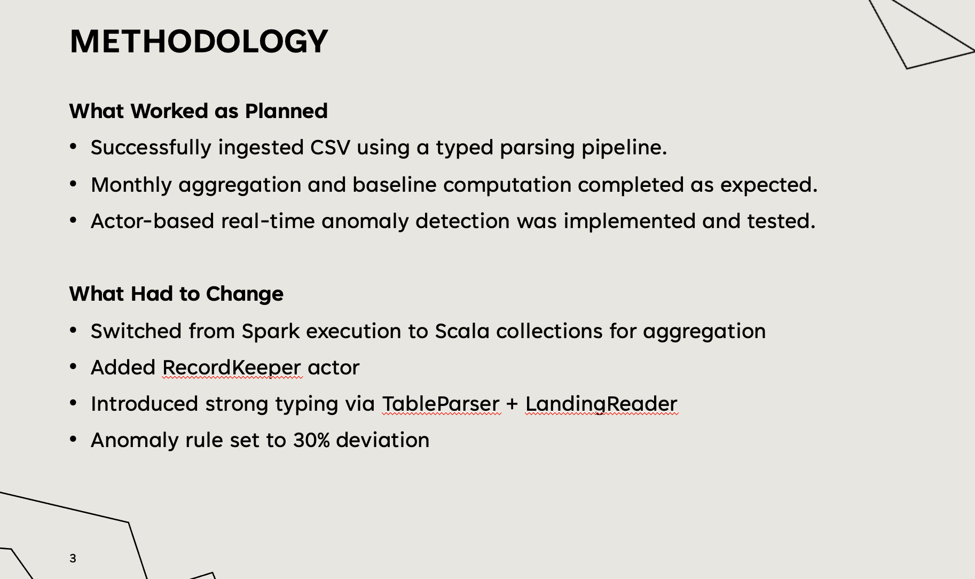
Notes:
Usage: Scala, with its functional programming capabilities, is used for application development. Spark, built on Scala, excels in processing large datasets in real-time.
Usage: MLlib is used to develop machine learning models that form the backbone of the recommendation engine.

Slide 9
Methodology—Data Cleaning
We built a three-layer data ingestion pipeline:
LandingTableParser: We use TableParser to convert raw CSV files into strongly typed rows (LandingRow) based on the exact column headers in the dataset.Parsing is performed by column name
Value Cleaning:Since the raw CSV data contains quotes, commas, missing values, and invalid characters, we use Formats.scala to clean and convert all critical fields. The system converts YYYYMM time values into YearMonth, and landing counts and weights into Long and Double. All conversions use Option for fault-tolerant.
The system converts cleaned LandingRow entries into LandingRecord and keeps only records with valid time, landing count, and weight, automatically filtering out all invalid data.

Slide 10
Core Data Model
LandingRecord
Period (YearMonth)
Airline
Geographical region
Aircraft type
Landing count
Landed weight
This becomes the single source of truth for:
Aggregation
Forecasting
Anomaly detection
Notes:
Usage: Scala, with its functional programming capabilities, is used for application development. Spark, built on Scala, excels in processing large datasets in real-time.
Usage: MLlib is used to develop machine learning models that form the backbone of the recommendation engine.

Slide 11
Methodolog—Core Analytics Pipeline
Batch Analytics Pipeline
Monthly Aggregation
Moving Average Baseline (6-month window)
Baseline Accuracy Evaluation
Time-Series Forecasting
Anomaly Detection
CSV Result Generation
Anomaly Rule
Deviation Threshold = 30%
If |actual − predicted| / actual > 0.3 → anomaly triggered
Notes:
Usage: Scala, with its functional programming capabilities, is used for application development. Spark, built on Scala, excels in processing large datasets in real-time.
Usage: MLlib is used to develop machine learning models that form the backbone of the recommendation engine.

Slide 12
Time-Series Forecasting Models
We implemented two forecasting strategies:
1.One-Step Forecast (for anomaly detection)
Average (Window = 6)
Used to compare against real values
2.Six-Month Global Forecast (for future trend)
Trend-based delta forecasting
Uses average monthly change
Outputs
Predicted landing count
Predicted landed weight
Notes:
Usage: Scala, with its functional programming capabilities, is used for application development. Spark, built on Scala, excels in processing large datasets in real-time.
Usage: MLlib is used to develop machine learning models that form the backbone of the recommendation engine.

Slide 13
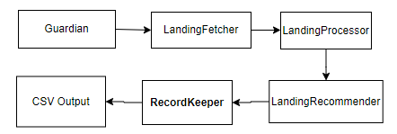
Actor-Based Reactive Architecture System implemented using Akka Typed Actors
Each Actor
Has a dedicated protocol
Communicates asynchronously
Fully decoupled and scalable
Notes:
Usage: Scala, with its functional programming capabilities, is used for application development. Spark, built on Scala, excels in processing large datasets in real-time.
Usage: MLlib is used to develop machine learning models that form the backbone of the recommendation engine.

Slide 14
Real-Time Anomaly Handling
LandingRecommender
Generates forecasts
Compares with actual values
Triggers anomaly events
RecordKeeper
Stores anomalies in memory
Logs full explainable anomaly details
Outputs:
output/anomalies.csv
Notes:
Usage: Scala, with its functional programming capabilities, is used for application development. Spark, built on Scala, excels in processing large datasets in real-time.
Usage: MLlib is used to develop machine learning models that form the backbone of the recommendation engine.

Slide 15
ANOMALY DETECTION
We set the threshold at 30%. If the difference between actual and predicted values
exceeds that, it gets flagged as an anomaly.We detected 71 anomalies in total,
and many of them match up with real-world events:
For example, Swissair dropped from 25 landings to just 2 in October 2001 because they went bankrupt that year. Compass Airlines had a huge drop in April 2020, clearly due to COVID-19. These anomalies aren't just noise — something actually happened
Example Anomalies Detected:
Airline | Period | Actual | Predicted | Deviation
Mesa Airlines | 2016-11 | 1 | 50.50 | 4950%
Virgin America | 2018-01 | 625 | 1755.83 | 181%
Swissair | 2001-10 | 2 | 25.00 | 1150%
Compass Airlines | 2020-04 | 2 | 86.00 | 4200%
Notes:
Usage: Scala, with its functional programming capabilities, is used for application development. Spark, built on Scala, excels in processing large datasets in real-time.
Usage: MLlib is used to develop machine learning models that form the backbone of the recommendation engine.

Slide 16
Output Products
Two Final CSV Deliverables:
Forecast Output
output/forecasts.csv
Airline + Next period + Predicted landing + Weight
Anomaly Output
output/anomalies.csv
Airline + Period + Actual + Predicted + Deviation %
Notes:
Usage: Scala, with its functional programming capabilities, is used for application development. Spark, built on Scala, excels in processing large datasets in real-time.
Usage: MLlib is used to develop machine learning models that form the backbone of the recommendation engine.

Slide 17
RESULTS SUMMARY
Processing Performance
Metric | Result
Records Loaded | 44,502
Monthly Aggregates | 15,458
Airlines Analyzed | 175
Processing Time | ~1.5 seconds
Analytics Output
Metric | Result
Baseline Accuracy | 63.52%
Anomalies Detected | 71
6-Month Forecasts | 966
Notes:
Usage: Scala, with its functional programming capabilities, is used for application development. Spark, built on Scala, excels in processing large datasets in real-time.
Usage: MLlib is used to develop machine learning models that form the backbone of the recommendation engine.

Slide 18
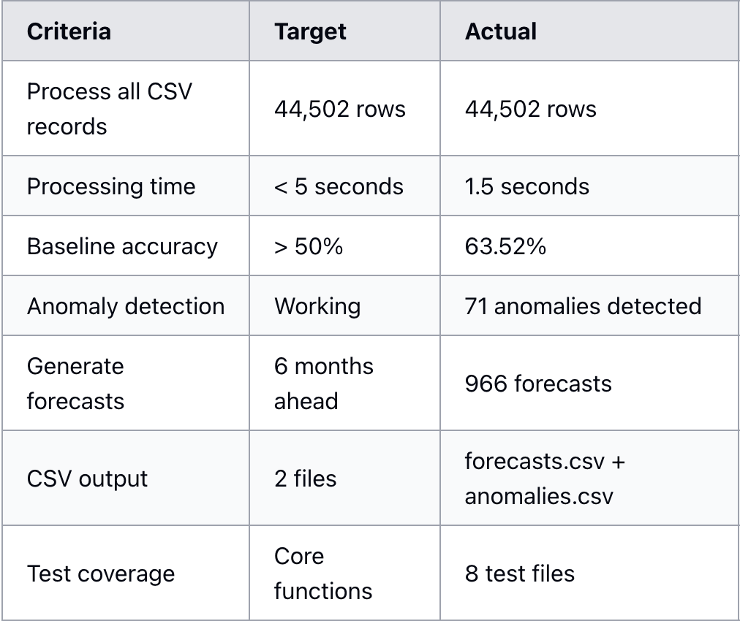
Acceptance criteria
Notes:
Usage: Scala, with its functional programming capabilities, is used for application development. Spark, built on Scala, excels in processing large datasets in real-time.
Usage: MLlib is used to develop machine learning models that form the backbone of the recommendation engine.

Slide 19
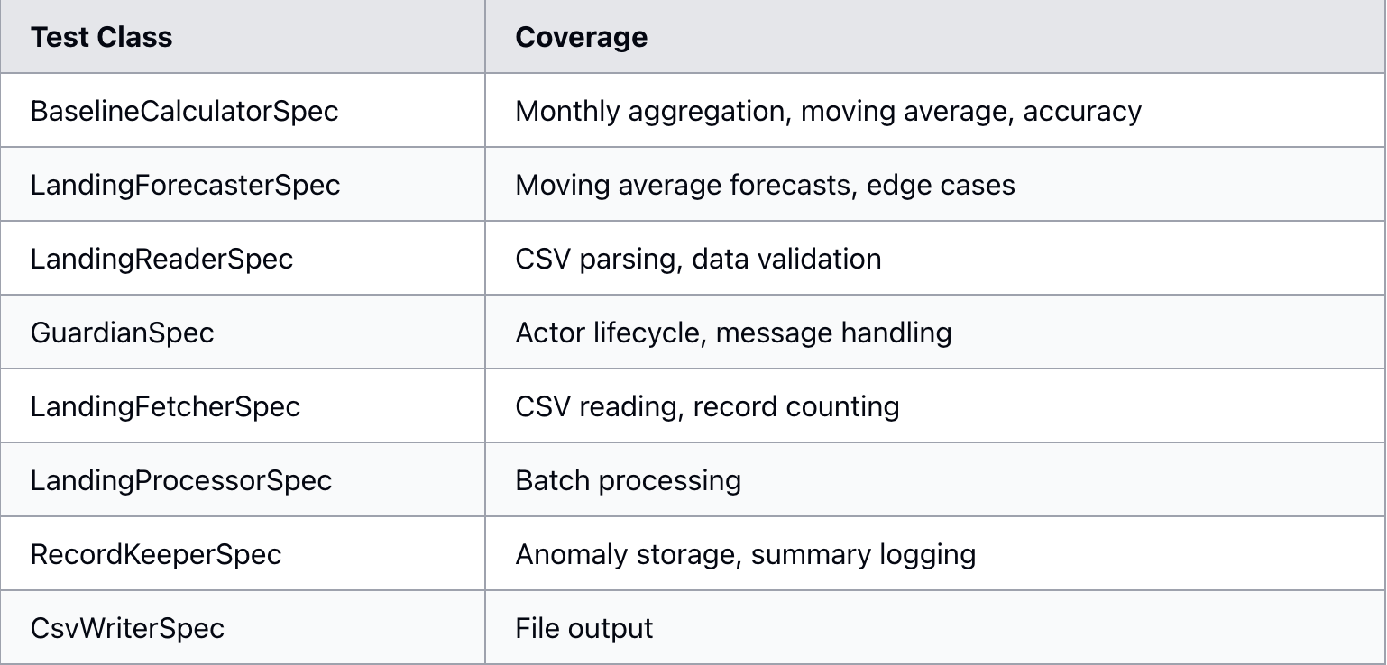
Testing
Notes:
Usage: Scala, with its functional programming capabilities, is used for application development. Spark, built on Scala, excels in processing large datasets in real-time.
Usage: MLlib is used to develop machine learning models that form the backbone of the recommendation engine.

Slide 20
USE CASES
Airport Operations
Predict landing volumes for resource planning
Detect unusual traffic patterns early
Airline Analysis
Track historical landing trends
Identify airlines with volatile operations
Anomaly Investigation
Flag significant deviations from expected patterns
Correlate with external events
Notes:
Usage: Scala, with its functional programming capabilities, is used for application development. Spark, built on Scala, excels in processing large datasets in real-time.
Usage: MLlib is used to develop machine learning models that form the backbone of the recommendation engine.

Slide 21

Thank you
Rakshith Narayanaswamy
Ziming Liang

